Slide 1
CSE214 – Analysis of Algorithms PhD Furkan Gözükara, Toros University https://github.com/FurkanGozukara/CSE214_2018
Lecture 4
The Divide-and-Conquer Design Paradigm
Based on Cevdet Aykanat’s and Mustafa Ozdal’s Lecture Notes - Bilkent

Slide 2




Reminder: Merge Sort
Input array A
Divide
sort this half
sort this half
Conquer
merge two sorted halves
Combine

Slide 3
The Divide-and-Conquer Design Paradigm
Divide the problem (instance) into subproblems.
Conquer the subproblems by solving them recursively.
Combine subproblem solutions.

Slide 4
Example: Merge Sort
Divide: Trivial.
Conquer: Recursively sort 2 subarrays.
Combine: Linear- time merge.
T(n) = 2 T(n/2) + Θ(n)
# subproblems
work dividing and combining
subproblem size

Slide 5








Master Theorem: Reminder T(n) = aT(n/b) + f(n)
_{n}log_{b} a
f (n)
T(n) = Θ(n^{logb a} )
Case 1:
= Ω(n^{ε} )
f (n)
= Θ(lg^{k} n)
_{n}log_{b} a
T(n) = Θ(n^{logb a} lg^{k+1} n)
Case 2:
f (n)
_{n}log_{b} a
= Ω(n^{ε} )
Case 3:
T(n) = Θ( f (n))
and
a f (n/b) ≤ c f (n) for c < 1
Notes:
Master teorem 1 soru sorarim

Slide 6

Merge Sort: Solving the Recurrence
T(n) = 2 T(n/2) + Θ(n)
a = 2, b = 2, f(n) = Θ(n),
_{n}log_{b}a _{= n}
f (n)
= Θ(lg^{k} n)
_{n}log_{b} a
T(n) = Θ(n^{logb a} lg^{k+1} n)
Case 2:
holds for k = 0
T(n) = Θ (nlgn)

Slide 7
Binary Search
Find an element in a sorted array:
Divide: Check middle element.
Conquer: Recursively search 1 subarray.
Combine: Trivial.
Example: Find 9
3 5 7 8 9 12 15

Slide 8
Binary Search
Find an element in a sorted array:
Divide: Check middle element.
Conquer: Recursively search 1 subarray.
Combine: Trivial.
Example: Find 9
3 5 7 8 9 12 15

Slide 9
Binary Search
Find an element in a sorted array:
Divide: Check middle element.
Conquer: Recursively search 1 subarray.
Combine: Trivial.
Example: Find 9
3 5 7 8 9 12 15

Slide 10
Binary Search
Find an element in a sorted array:
Divide: Check middle element.
Conquer: Recursively search 1 subarray.
Combine: Trivial.
Example: Find 9
3 5 7 8 9 12 15

Slide 11
Binary Search
Find an element in a sorted array:
Divide: Check middle element.
Conquer: Recursively search 1 subarray.
Combine: Trivial.
Example: Find 9
3 5 7 8 9 12 15

Slide 12
Binary Search
Find an element in a sorted array:
Divide: Check middle element.
Conquer: Recursively search 1 subarray.
Combine: Trivial.
Example: Find 9
3 5 7 8 9 12 15

Slide 13
Recurrence for Binary Search
T(n) = 1 T(n/2) + Ө(1)
work dividing and combining
# subproblems
subproblem size

Slide 14
Binary Search: Solving the Recurrence
T(n) = T(n/2) + Θ(1)
a = 1, b = 2, f(n) = Θ(1),
_{n}log_{b}a _{= n0= 1}
f (n)
= Θ(lg^{k} n)
_{n}log_{b} a
T(n) = Θ(n^{logb a} lg^{k+1} n)
Case 2:
holds for k = 0
T(n) = Θ (lgn)

Slide 15
Powering a Number
Problem: Compute a^{n}, where n is a natural number
Naive-Power (a, n)
powerVal ← 1 for i ← 1 to n
powerVal ← powerVal . a return powerVal
What is the complexity?
T(n) = Θ (n)

Slide 16
Powering a Number: Divide & Conquer
Basic idea:
_{a}n/2 . _{a}n/2 even
_{a}(n-1)/2 . _{a}(n-1)/2 . _{a}
if n is
a^{n} =
if n is odd
E$xample: 3^{7}=3^{3}×3^{3}×3$
E$xample: 3^{8}=3^{4}×3^{4}$

Slide 17
Powering a Number: Divide & Conquer
POWER (a, n)
if n = 0 then return 1
else if n is even then
val ← POWER (a, n/2) return val * val
else if n is odd then
val ← POWER (a, (n-1)/2) return val * val * a

Slide 18
Powering a Number: Solving the Recurrence
T(n) = T(n/2) + Θ(1)
a = 1, b = 2, f(n) = Θ(1),
_{n}log_{b}a _{= n0= 1}
f (n)
= Θ(lg^{k} n)
_{n}log_{b} a
T(n) = Θ(n^{logb a} lg^{k+1} n)
Case 2:
holds for k = 0
T(n) = Θ (lgn)

Slide 19









Matrix Multiplication
Input : A = [a_{ij}], B = [b_{ij}].
Output: C = [c_{ij}] = A.B.
i , j = 1, 2, ... , n.
c₁₁ c₁₂ ... c_{1n} a₁₁ a₁₂ ... a_{1n}
b₁₂ ... b_{1n}
b₂₂ ... b_{2n}
b_{n2} ... b_{nn}
^{b}11
^{b}21
^{b}n1
c₂₁ c₂₂ ... c_{2n} a₂₁ a₂₂ ... a_{2n}
=
.
...
...
...
...
...
...
...
...
...
c_{n1} c_{n2} ... c_{nn} a_{n1} a_{n2} ... a_{nn}
^{c}ij ^{= ∑}1≤ k ≤ n ªik ^{.b}kj

Slide 20
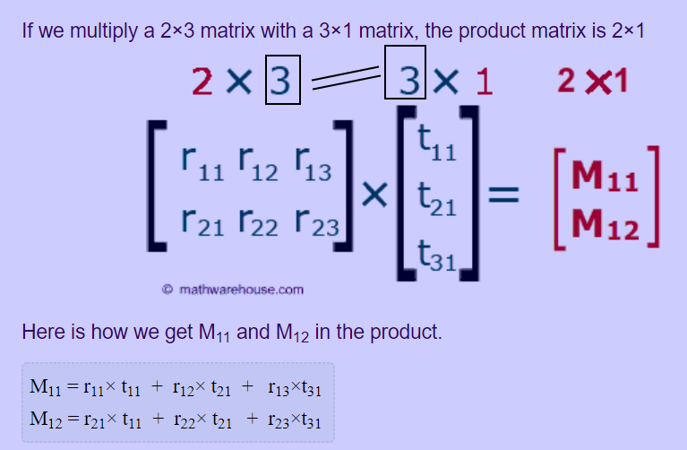

Slide 21
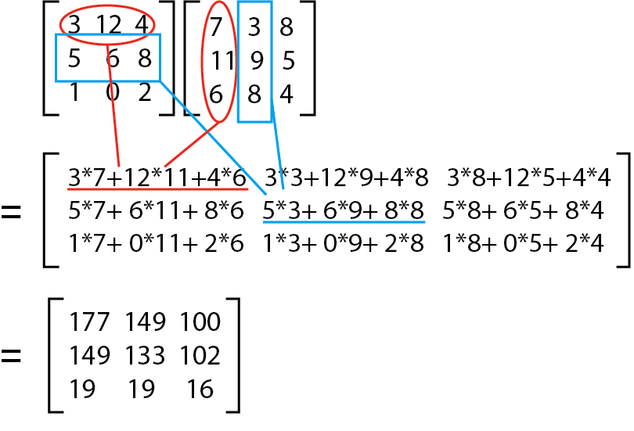

Slide 22
Standard Algorithm
for i ← 1 to n
do for j ← 1 to n
do c_{ij} ← 0
for k ← 1 to n
do c_{ij} ← c_{ij} + a_{ik} . b_{kj}
Running time = Θ(n³)
Notes:
Set all cIJs to 0

Slide 23
Matrix Multiplication: Divide & Conquer
IDEA: Divide the n x n matrix into
2x2 matrix of (n/2)x(n/2) submatrices
C A B
_^{c}1_1 _^{c}_12 ₌ _ª1_1 _ª_12 . _^{b}_11 _^{b}_12
^{c}21 ^{c}22 ª21 ª22 ^{b}21 ^{b}22
_ _ _ _
_ _ _ _
_ _ _ _
^{c}11 ^{= a}11 ^{b}11 ^{+ a}12 ^{b}21

Slide 24
Matrix Multiplication: Divide & Conquer
IDEA: Divide the n x n matrix into
2x2 matrix of (n/2)x(n/2) submatrices
C A B
_^{c}1_1 _^{c}_12 ₌ _ª1_1 _ª_12 . _^{b}_11 _^{b}_12
^{c}21 ^{c}22 ª21 ª22 ^{b}21 ^{b}22
_ _ _ _
_ _ _ _
_ _ _ _
^{c}12 ^{= a}11 ^{b}12 ^{+ a}12 ^{b}22

Slide 25
Matrix Multiplication: Divide & Conquer
IDEA: Divide the n x n matrix into
2x2 matrix of (n/2)x(n/2) submatrices
C A B
_^{c}1_1 _^{c}_12 ₌ _ª1_1 _ª_12 . _^{b}_11 _^{b}_12
^{c}21 ^{c}22 ª21 ª22 ^{b}21 ^{b}22
_ _ _ _
_ _ _ _
_ _ _ _
^{c}21 ^{= a}21 ^{b}11 ^{+ a}22 ^{b}21

Slide 26
Matrix Multiplication: Divide & Conquer
IDEA: Divide the n x n matrix into
2x2 matrix of (n/2)x(n/2) submatrices
C A B
_^{c}1_1 _^{c}_12 ₌ _ª1_1 _ª_12 . _^{b}_11 _^{b}_12
^{c}21 ^{c}22 ª21 ª22 ^{b}21 ^{b}22
_ _ _ _
_ _ _ _
_ _ _ _
^{c}22 ^{= a}21 ^{b}12 ^{+ a}22 ^{b}22

Slide 27
Matrix Multiplication: Divide & Conquer
C
_^{c}1_1 _^{c}1_2
^{c}21 ^{c}22
A
₌ _ª1_1 _ª_12
ª21 ª22
B
. _^{b}_11 _^{b}_12
^{b}21 ^{b}22
_ _ _ _
_ _ _ _
_ _ _ _
^{c}11 ^{= a}11 ^{b}11 ^{+ a}12 ^{b}21 ^{c}12 ^{= a}11 ^{b}12 ^{+ a}12 ^{b}22 ^{c}21 ^{= a}21 ^{b}11 ^{+ a}22 ^{b}21 ^{c}22 ^{= a}21 ^{b}12 ^{+ a}22 ^{b}22
8 mults of (n/2)x(n/2) submatrices
4 adds of (n/2)x(n/2) submatrices

Slide 28
Matrix Multiplication: Divide & Conquer
MATRIX-MULTIPLY (A, B)
// Assuming that both A and B are nxn matrices
if n = 1 then return A * B
else
partition A, B, and C as shown before
c₁₁ = MATRIX-MULTIPLY(a₁₁, b₁₁) + MATRIX-MULTIPLY(a₁₂, b₂₁) c₁₂ = MATRIX-MULTIPLY(a₁₁, b₁₂) + MATRIX-MULTIPLY(a₁₂, b₂₂)
c₂₁ = MATRIX-MULTIPLY(a₂₁, b₁₁) + MATRIX-MULTIPLY(a₂₂, b₂₁) c₂₂ = MATRIX-MULTIPLY(a₂₁, b₁₂) + MATRIX-MULTIPLY(a₂₂, b₂₂)
return C

Slide 29
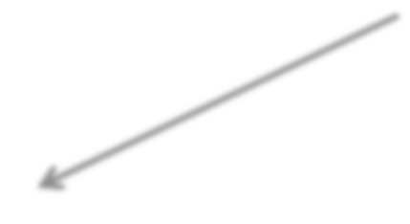

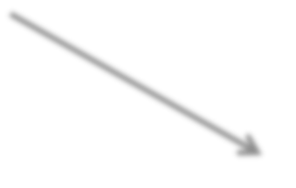
Matrix Multiplication: Divide & Conquer Analysis
T(n) = 8 T(n/2) + Θ(n²)
8 recursive calls
each subproblem has size n/2
submatrix addition

Slide 30
Matrix Multiplication: Solving the Recurrence
T(n) = 8 T(n/2) + Θ(n²)
a = 8, b = 2, f(n) = Θ(n²),
_{n}log_{b}a _{= n3}
_{n}log_{b} a
f (n)
T(n) = Θ(n^{logb a} )
Case 1:
= Ω(n^{ε} )
T(n) = Θ (n³)
No better than the ordinary algorithm!

Slide 31
Matrix Multiplication: Strassen’s Idea
C
_^{c}1_1 _^{c}1_2
^{c}21 ^{c}22
A
₌ _ª1_1 _ª_12
ª21 ª22
B
. _^{b}_11 _^{b}_12
^{b}21 ^{b}22
_ _ _ _
_ _ _ _
_ _ _ _
Compute c₁₁, c₁₂, c₂₁, and c₂₂ using 7 recursive multiplications

Slide 32
Matrix Multiplication: Strassen’s Idea
P₁ = a₁₁ x (b₁₂ - b₂₂ ) P₂ = (a₁₁ + a₁₂ ) x b₂₂ P₃ = (a₂₁ + a₂₂ ) x b₁₁ P₄ = a₂₂ x (b₂₁ - b₁₁ )
P₅ = (a₁₁ + a₂₂ ) x (b₁₁ + b₂₂ ) P₆ = (a₁₂ - a₂₂ ) x (b₂₁ + b₂₂ ) P₇ = ( a₁₁ - a₂₁ ) x (b₁₁ + b₁₂ )
Reminder: Each submatrix is of size (n/2)x(n/2)
Each add/sub operation takes Θ(n²) time
Compute P₁..P₇ using 7 recursive calls to
matrix-multiply
How to compute c_{ij} using P₁.. P₇ ?

Slide 33
Matrix Multiplication: Strassen’s Idea
P₁ = a₁₁ x (b₁₂ - b₂₂ ) P₂ = (a₁₁ + a₁₂ ) x b₂₂
c₁₁ = P₅ + P₄ – P₂ + P₆ c₁₂ = P₁ + P₂
c₂₁ = P₃ + P₄
c₂₂ = P₅ + P₁ – P₃ – P₇
P = (a
+ a ) x b
3 21 22 11
P₄ = a₂₂ x (b₂₁ - b₁₁ )
P₅ = (a₁₁ + a₂₂ ) x (b₁₁ + b₂₂ ) P₆ = (a₁₂ - a₂₂ ) x (b₂₁ + b₂₂ ) P₇ = ( a₁₁ - a₂₁ ) x (b₁₁ + b₁₂ )
7 recursive multiply calls 18 add/sub operations
Does not rely on commutativity of multiplication

Slide 34
Matrix Multiplication: Strassen’s Idea
P₁ = a₁₁ x (b₁₂ - b₂₂ )
e.g. Show that c₁₂ = P₁+P₂
c₁₂ = P₁ + P₂
= a₁₁(b₁₂–b₂₂)+(a₁₁+a₁₂)b₂₂
^{= a}11^{b}12^{-a}11^{b}22^{+a}11^{b}22^{+a}12^{b}22
^{= a}11^{b}12^{+a}12^{b}22
P = (a
+ a ) x b
2 11 12 22
P₃ = (a₂₁ + a₂₂ ) x b₁₁ P₄ = a₂₂ x (b₂₁ - b₁₁ )
P = (a
+ a ) x (b + b )
5 11 22 11 22
P₆ = (a₁₂ - a₂₂ ) x (b₂₁ + b₂₂ ) P₇ = ( a₁₁ - a₂₁ ) x (b₁₁ + b₁₂ )

Slide 35
Strassen’s Algorithm
Divide: Partition A and B into (n/2) x (n/2) submatrices. Form terms to be multiplied using + and –.
Conquer: Perform 7 multiplications of (n/2) x (n/2) submatrices recursively.
Combine: Form C using + and – on (n/2) x (n/2) submatrices.
Recurrence: T(n) = 7 T(n/2) + Ө(n²)

Slide 36
Strassen’s Algorithm: Solving the Recurrence
T(n) = 7 T(n/2) + Θ(n²)
a = 7, b = 2, f(n) = Θ(n²),
_{n}log_{b}a _{= nlg7}
_{n}log_{b} a
f (n)
T(n) = Θ(n^{logb a} )
Case 1:
= Ω(n^{ε} )
T(n) = Θ (n^{lg7})
Note: lg7 ≈ 2.81

Slide 37
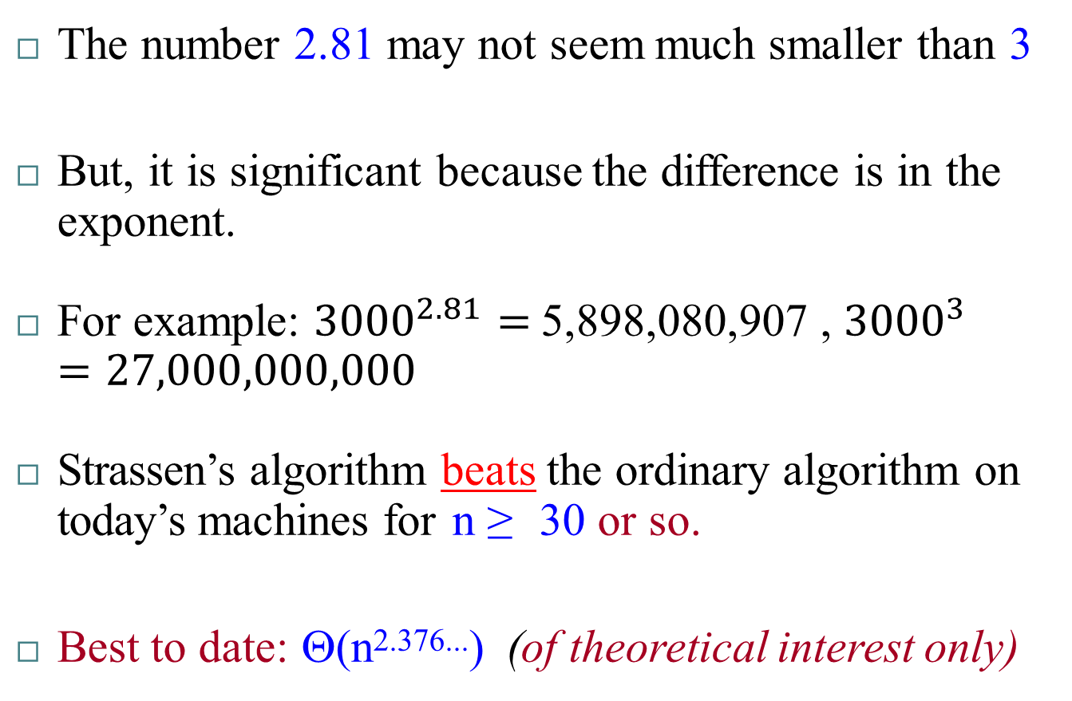
Strassen’s Algorithm
The number 2.81 may not seem much smaller than 3
But, it is significant because the difference is in the exponent.
For example: ${3000}^{2.81}=$5,898,080,907 , ${3000}^{3}=27,000,000,000$
Strassen’s algorithm beats the ordinary algorithm on today’s machines for n ≥ 30 or so.
Best to date: Θ(n^{2.376...}) (of theoretical interest only)

Slide 38








VLSI (Very-large-scale integration) Layout: Binary Tree Embedding
Problem: Embed a complete binary tree with n leaves into a 2D grid with minimum area.
Example:

Slide 39
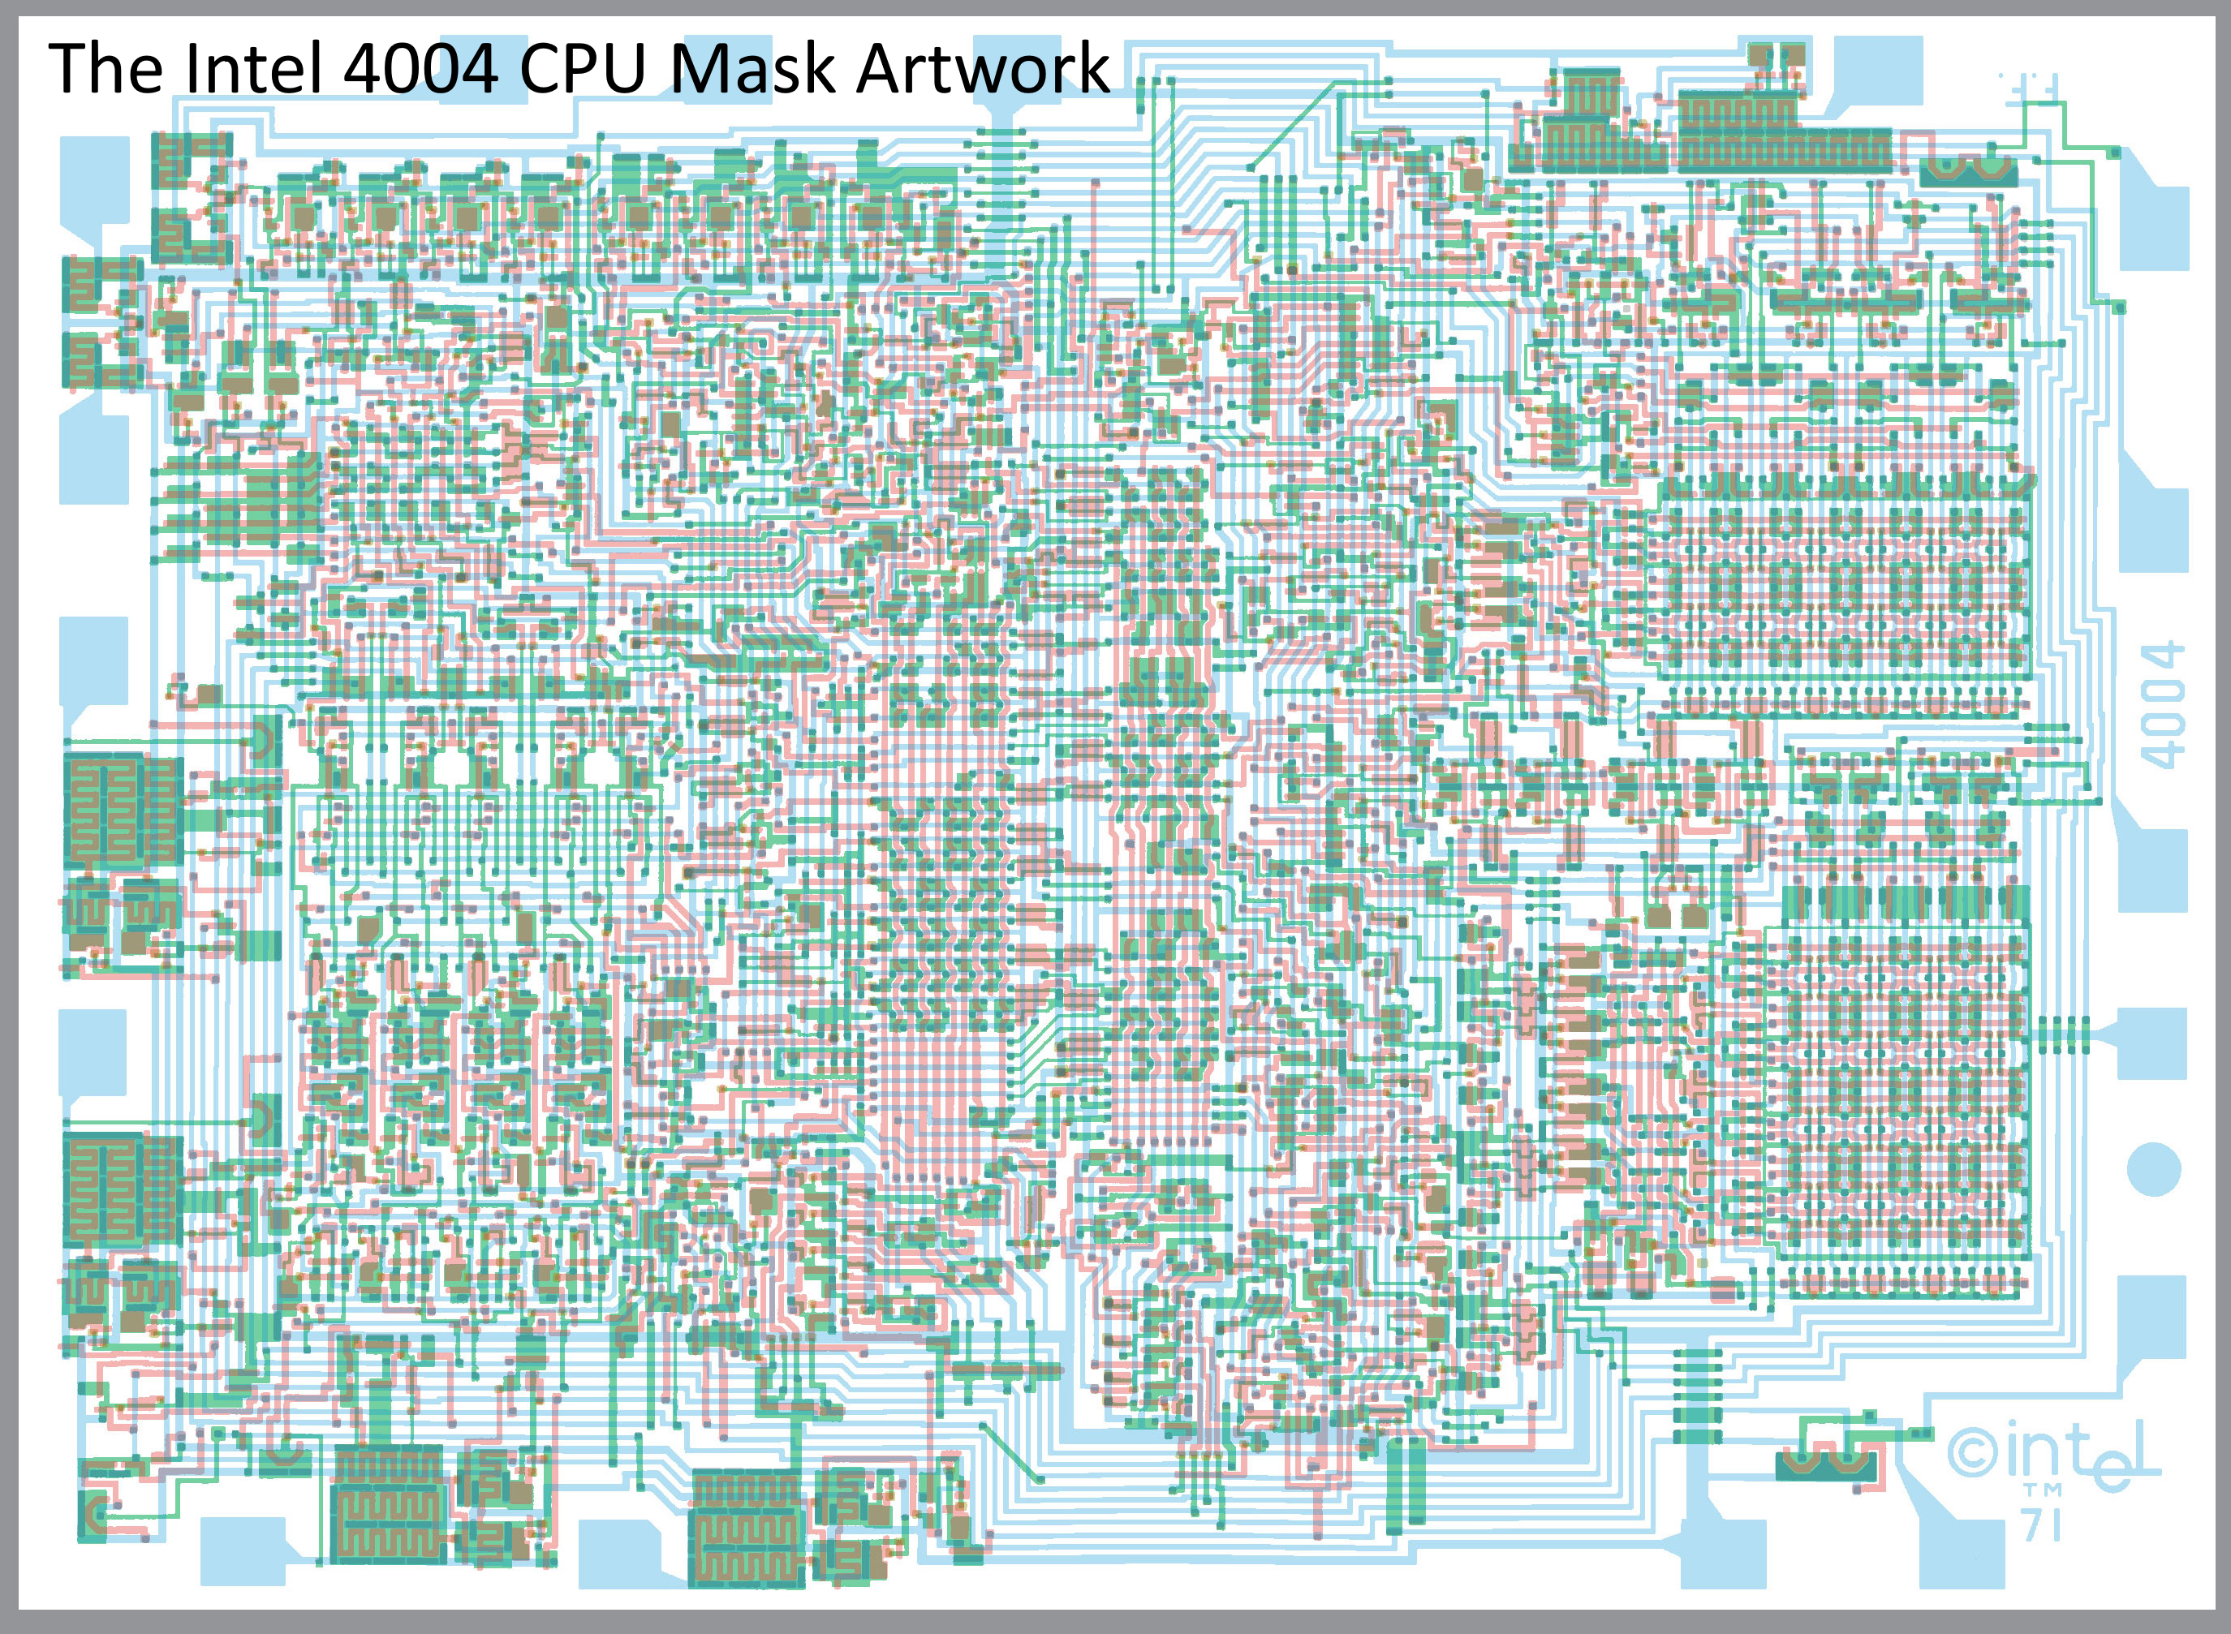

Slide 40
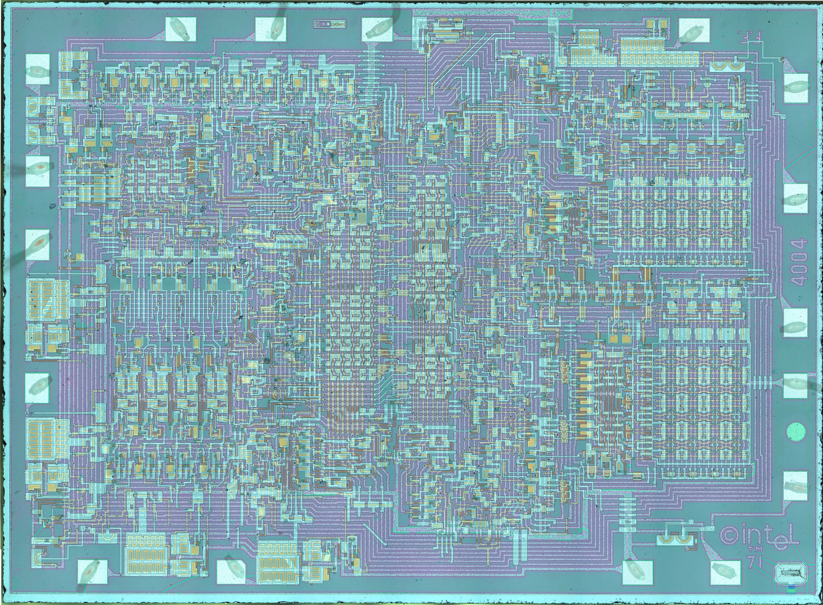

Slide 41
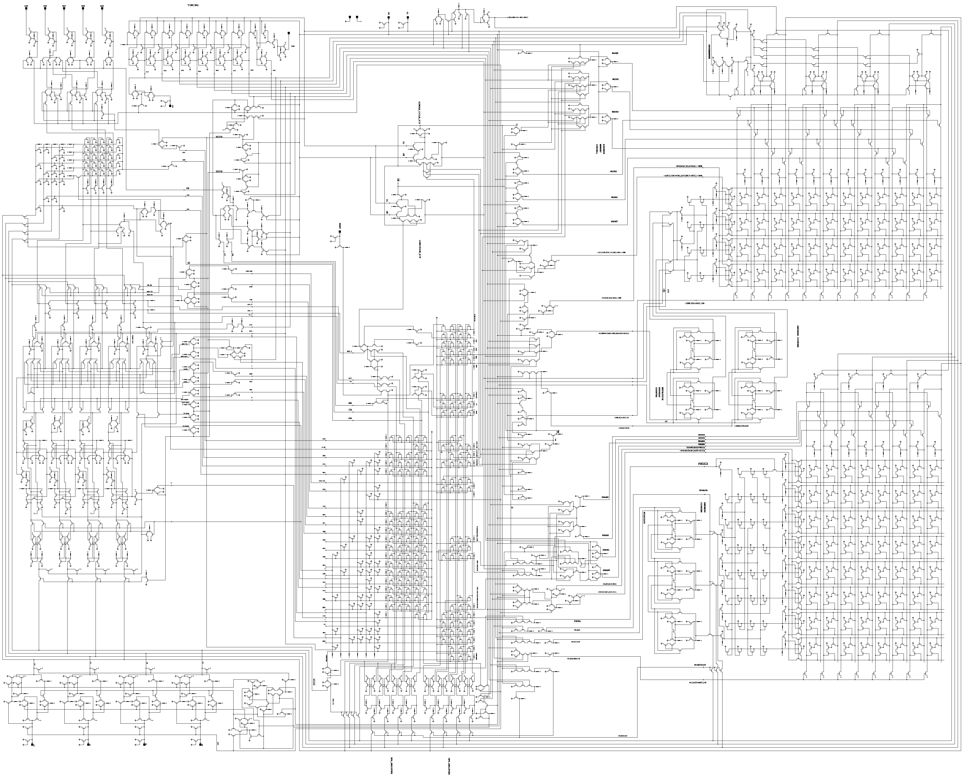

Slide 42



Binary Tree Embedding
Use divide and conquer
root
Embed the root node
Embed the left subtree
Embed the right subtree
LEFT SUBTREE
RIGHT SUBTREE
What is the min-area required for n leaves?

Slide 43


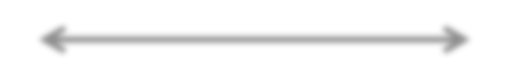
Binary Tree Embedding
root
EMBED LEFT SUBTREE HERE
EMBED RIGHT SUBTREE HERE
H(n) = H(n/2) + 1
H(n/2)
W(n/2) W(n/2)
W(n) = 2W(n/2) + 1

Slide 44
Master Theorem: Reminder T(n) = aT(n/b) + f(n)
_{n}log_{b} a
f (n)
T(n) = Θ(n^{logb a} )
Case 1:
= Ω(n^{ε} )
f (n)
= Θ(lg^{k} n)
_{n}log_{b} a
T(n) = Θ(n^{logb a} lg^{k+1} n)
Case 2:
f (n)
_{n}log_{b} a
= Ω(n^{ε} )
Case 3:
T(n) = Θ( f (n))
and
a f (n/b) ≤ c f (n) for c < 1
Notes:
Master teorem 1 soru sorarim

Slide 45
Binary Tree Embedding
Solve the recurrences: W(n) = 2W(n/2) + 1 H(n) = H(n/2) + 1
➔ W(n) = Ө(n)
➔ H(n) = Ө(lgn)
Area(n) = Ө(nlgn)

Slide 46
Binary Tree Embedding
Example:
W(n)
H(n)

Slide 47






Binary Tree Embedding: H-Tree
Use a different divide and conquer method
root
Embed root, left, right nodes
Embed subtree 1
Embed subtree 2
Embed subtree 3
Embed subtree 4
left
right
subtree
1
subtree
2
subtree subtree
3 4
What is the min-area required for n leaves?

Slide 48


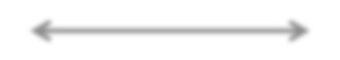
Binary Tree Embedding: H-Tree
SUBTREE 1
SUBTREE 2
H(n/4)
W(n) = 2W(n/4) + 1
H(n) = 2H(n/4) + 1
H(n/4)
SUBTREE 3
SUBTREE 4
W(n/4)
W(n/4)

Slide 49
Master Theorem: Reminder T(n) = aT(n/b) + f(n)
_{n}log_{b} a
f (n)
T(n) = Θ(n^{logb a} )
Case 1:
= Ω(n^{ε} )
f (n)
= Θ(lg^{k} n)
_{n}log_{b} a
T(n) = Θ(n^{logb a} lg^{k+1} n)
Case 2:
f (n)
_{n}log_{b} a
= Ω(n^{ε} )
Case 3:
T(n) = Θ( f (n))
and
a f (n/b) ≤ c f (n) for c < 1

Slide 50
Binary Tree Embedding: H-Tree
Solve the recurrences: W(n) = 2W(n/4) + 1 H(n) = 2H(n/4) + 1
➔ W(n) = Ө( n )
➔ H(n) = Ө( n )
Area(n) = Ө(n)

Slide 51
Binary Tree Embedding: H-Tree
Example:
W(n)
H(n)

Slide 52






Maximum Subarray Problem
Input: An array of values
Output: The contiguous subarray that has the largest sum of elements
Input array:
13
-3
-25
20
-3
-16
-23
18
20
-7
12
-22
-4
7
the maximum contiguous subarray

Slide 53



Maximum Subarray Problem: Divide & Conquer
Basic idea:
Divide the input array into 2 from the middle
Pick the best solution among the following:
The max subarray of the left half
The max subarray of the right half
The max subarray crossing the mid-point
Crosses the mid-point
A
Entirely in the left half
Entirely in the right half

Slide 54
Maximum Subarray Problem: Divide & Conquer
Divide: Trivial (divide the array from the middle)
Conquer: Recursively compute the max subarrays of the left and right halves
Combine: Compute the max-subarray crossing the mid- point (can be done in Θ(n) time). Return the max among the following:
the max subarray of the left subarray
the max subarray of the right subarray
the max subarray crossing the mid-point

Slide 55
Conclusion
Divide and conquer is just one of several powerful techniques for algorithm design.
Divide-and-conquer algorithms can be analyzed using recurrences and the master method (so practice this math).
Can lead to more efficient algorithms

